Slide 1
Topic 15 Format String Attack
ST251Z Ethical Hacking and Defences

Slide 2
Format String
First programming exercise: HelloWorld
Alert(), MsgBox(), System.out.println(), printf()
Takes whatever strings you specifies and display them in the output console

Slide 3
Simple problem
What does this C program do?
int main(int argc, char *argv[])
{
printf("%s",argv[1]);
return 0;
}
formatit.c
The program will print out the first argument

Slide 4
Simple problem
What happens if the format string %s is missing from the printf line?
int main(int argc, char *argv[])
{
printf(argv[1]);
return 0;
}
formatit.c
The program can still print out the first argument.
However, the program is now vulnerable to a format string attack.

Slide 5
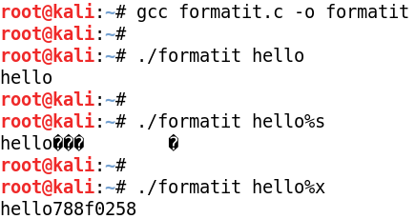
What is the output?
If you run formatit with a string argument, it will print out that string
But if you run formatit with %s or %x in the argument, the program will print the value in the top of stack

Slide 6
Practical
Try Practical Exercise 1
Use Format String attacks to view contents of stack

Slide 7
Use Perl or Python to print characters
In Format String attacks, we may need to repeat a sequence of characters repeatedly
./formatit %x.%x.%x.%x.%x.%x.%x.%x
Perl or Python can help
./formatit $(perl -e 'print("%x." x 8)')
./formatit $(python -c 'print("%x." * 8)')
Perl and Python can also print any character using its Ascii code by using \xNN where NN is the Ascii code of the character in hexadecimal
./formatit $(perl -e ‘print(“%x.” x 4, ”\x61\x62”)’)
./formatit $(python -c ‘print(“%x.” * 4 + chr(0x61) + chr(0x62))’)

Slide 8
Reading the stack
If the stack looks like: lower memory higher memory
top of stack-> 18 44 f9 77 c2 44 f9 77
Then, formatit hello,%x,%x would return: hello,77f94418,77f944c2
Potentially, can read the entire stack
Including sensitive info like password, keys, etc, which may be found in the stack
The first two words in the stack (one word = four bytes)
Remember Little Endian byte order is used

Slide 9
Crashing the application
If running formatit %x,%x,%x returns :
77f94418,77f944c2,0012fe10
You can crash the application by reading the memory content pointed to by the addresses in the stack formatit %s%s%s
This will attempt to read memory pointed by 77f94418, 77f944c,0012fe10
Application can crash as access to memory address 0012fe10 is prohibited
The first three words in the stack (one word = four bytes)

Slide 10
Crash the application
Crashing our own application is not fun
The same technique can be used to crash remote applications, eg a remote web service
Hence, resulting in denial of service attack

Slide 11
Write to stack
%n – writes the number of characters formatted by the printf function to the specified memory address.
Eg: Running formatit %x_%x_%x gives the result: 80000_6f38c_7ffdf000
Note the last %x gives the value 7ffdf000

Slide 12
Write to stack
We now do a %n: formatit %x_%x_%n
String printed out : 80000_6f38c_
Number of characters printed out : 12 (in decimal), or 0C in hexadecimal
So the value of 0C (or 0x0C) will be written to the address 0x7ffdf000

Slide 13
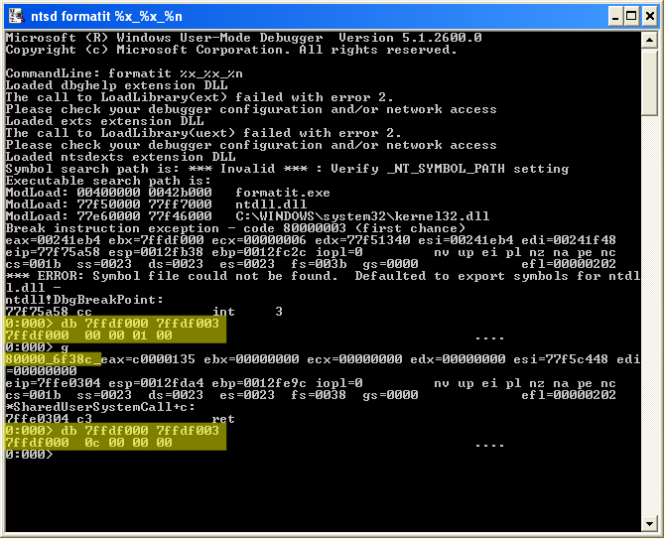
The address 7ffdf000 now contains the value 0C

Slide 14
Demo
main(int argc, char *argv[])
{
int a=1;
int b=2;
int c=8;
printf("%p,%p",&a,a);
printf(argv[1]);
return 0;
}
This printf is missing the format string, eg %s, so it is vulnerable to a format string attack

Slide 15
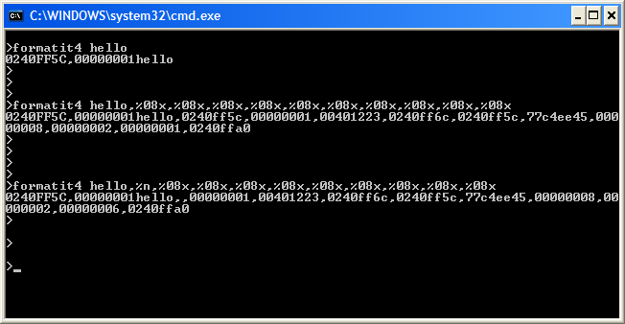
Demo
The contents of the stack could be displayed and modified

Slide 16
Practical
Exercise 2
Format Parameter %n
Exercise 3 and Exercise 4
Using Format String vulnerabilities to change the values of local variables
Exercise 5
Using a Debugger
Exercise 6 and Exercise 7
Using the Debugger to examine and change memory

Slide 17
Exploiting the stack
The holy grail of format string exploit => execute arbitrary code
The hacker will try to insert his code as part of the input string and cause the return pointer on the stack to execute his inserted code.

Slide 18
Fixing the vulnerability
Find codes that formats user input
Ensure that these codes format specifiers eg. printf(“%s”, userinput)
Automated tools available:
RATS – free scanner for C, C++
Flawfinder – opensource scanner for C, C++

Slide 19
Fixing the vulnerability
Automated tools available:
PSCAN – open source dedicated format string scanner
Automated tools may generate ‘false positives’
Black box testing with ‘%x’, ‘%s’, ‘%n’ can also uncover format string vulnerabilities

Slide 20
Windows DEP
Since Windows XP SP 2, MS Windows has a built in Data Execution Prevention (DEP) turned on by default for essential services
Prevents execution of code in the stack
Hence preventing format string exploits

